Slide 1

Care Connect
Presented by : Samita Maggo
Instructor : Prof. LaTonya Lewis

Slide 2
Agenda
Overview
Tools and Technologies
Database Diagram
Use Cases
Challenges
Future Considerations
Demo

Slide 3
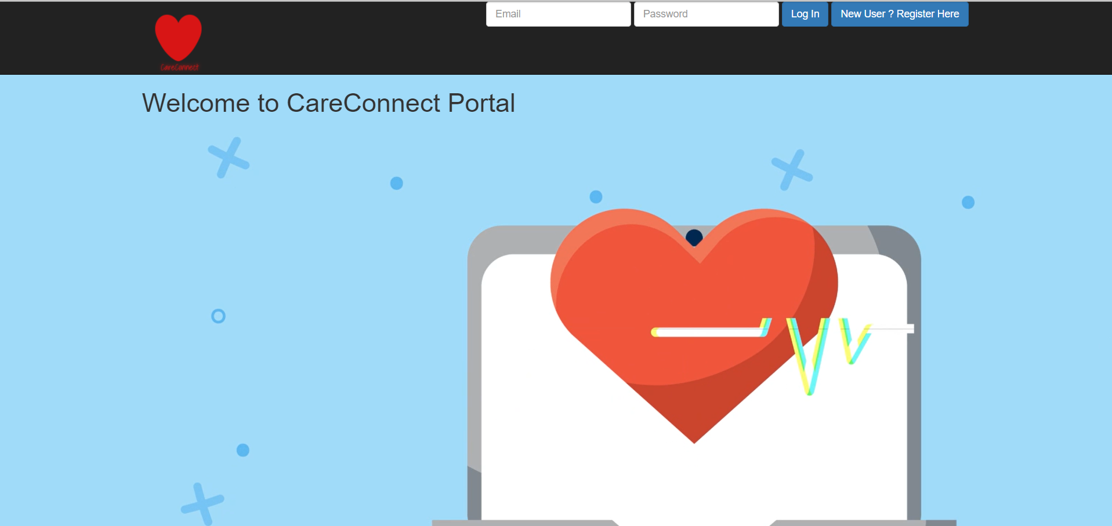
Overview
Care Connect is a Patient Portal for clinics to help its patients/doctors manage their appointments.

Slide 4
Tools & Technologies
Spring Boot
Thymeleaf
HTML / CSS / JQUERY
MySQL
Spring Security
Spring Data
JPA / Hibernate
JUnit Testing
GitHub

Slide 5
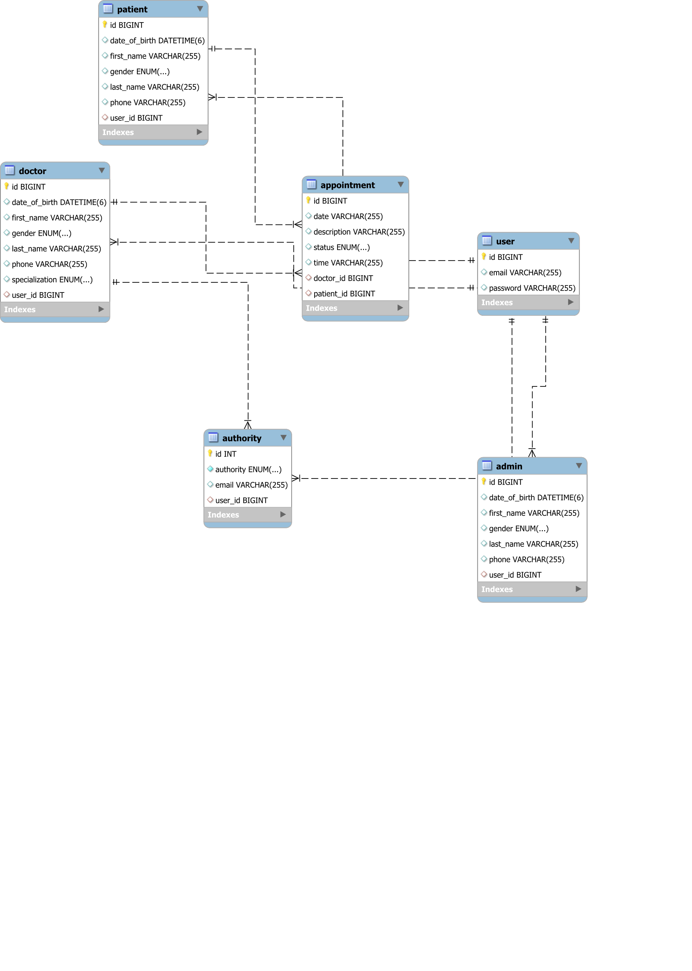
Database Diagram

Slide 6
Use Cases
Patient
Registration Online
Create/Update/Cancel an appointment
Doctor
Accept/Reject an appointment
Admin
Add/Delete Doctor information

Slide 7
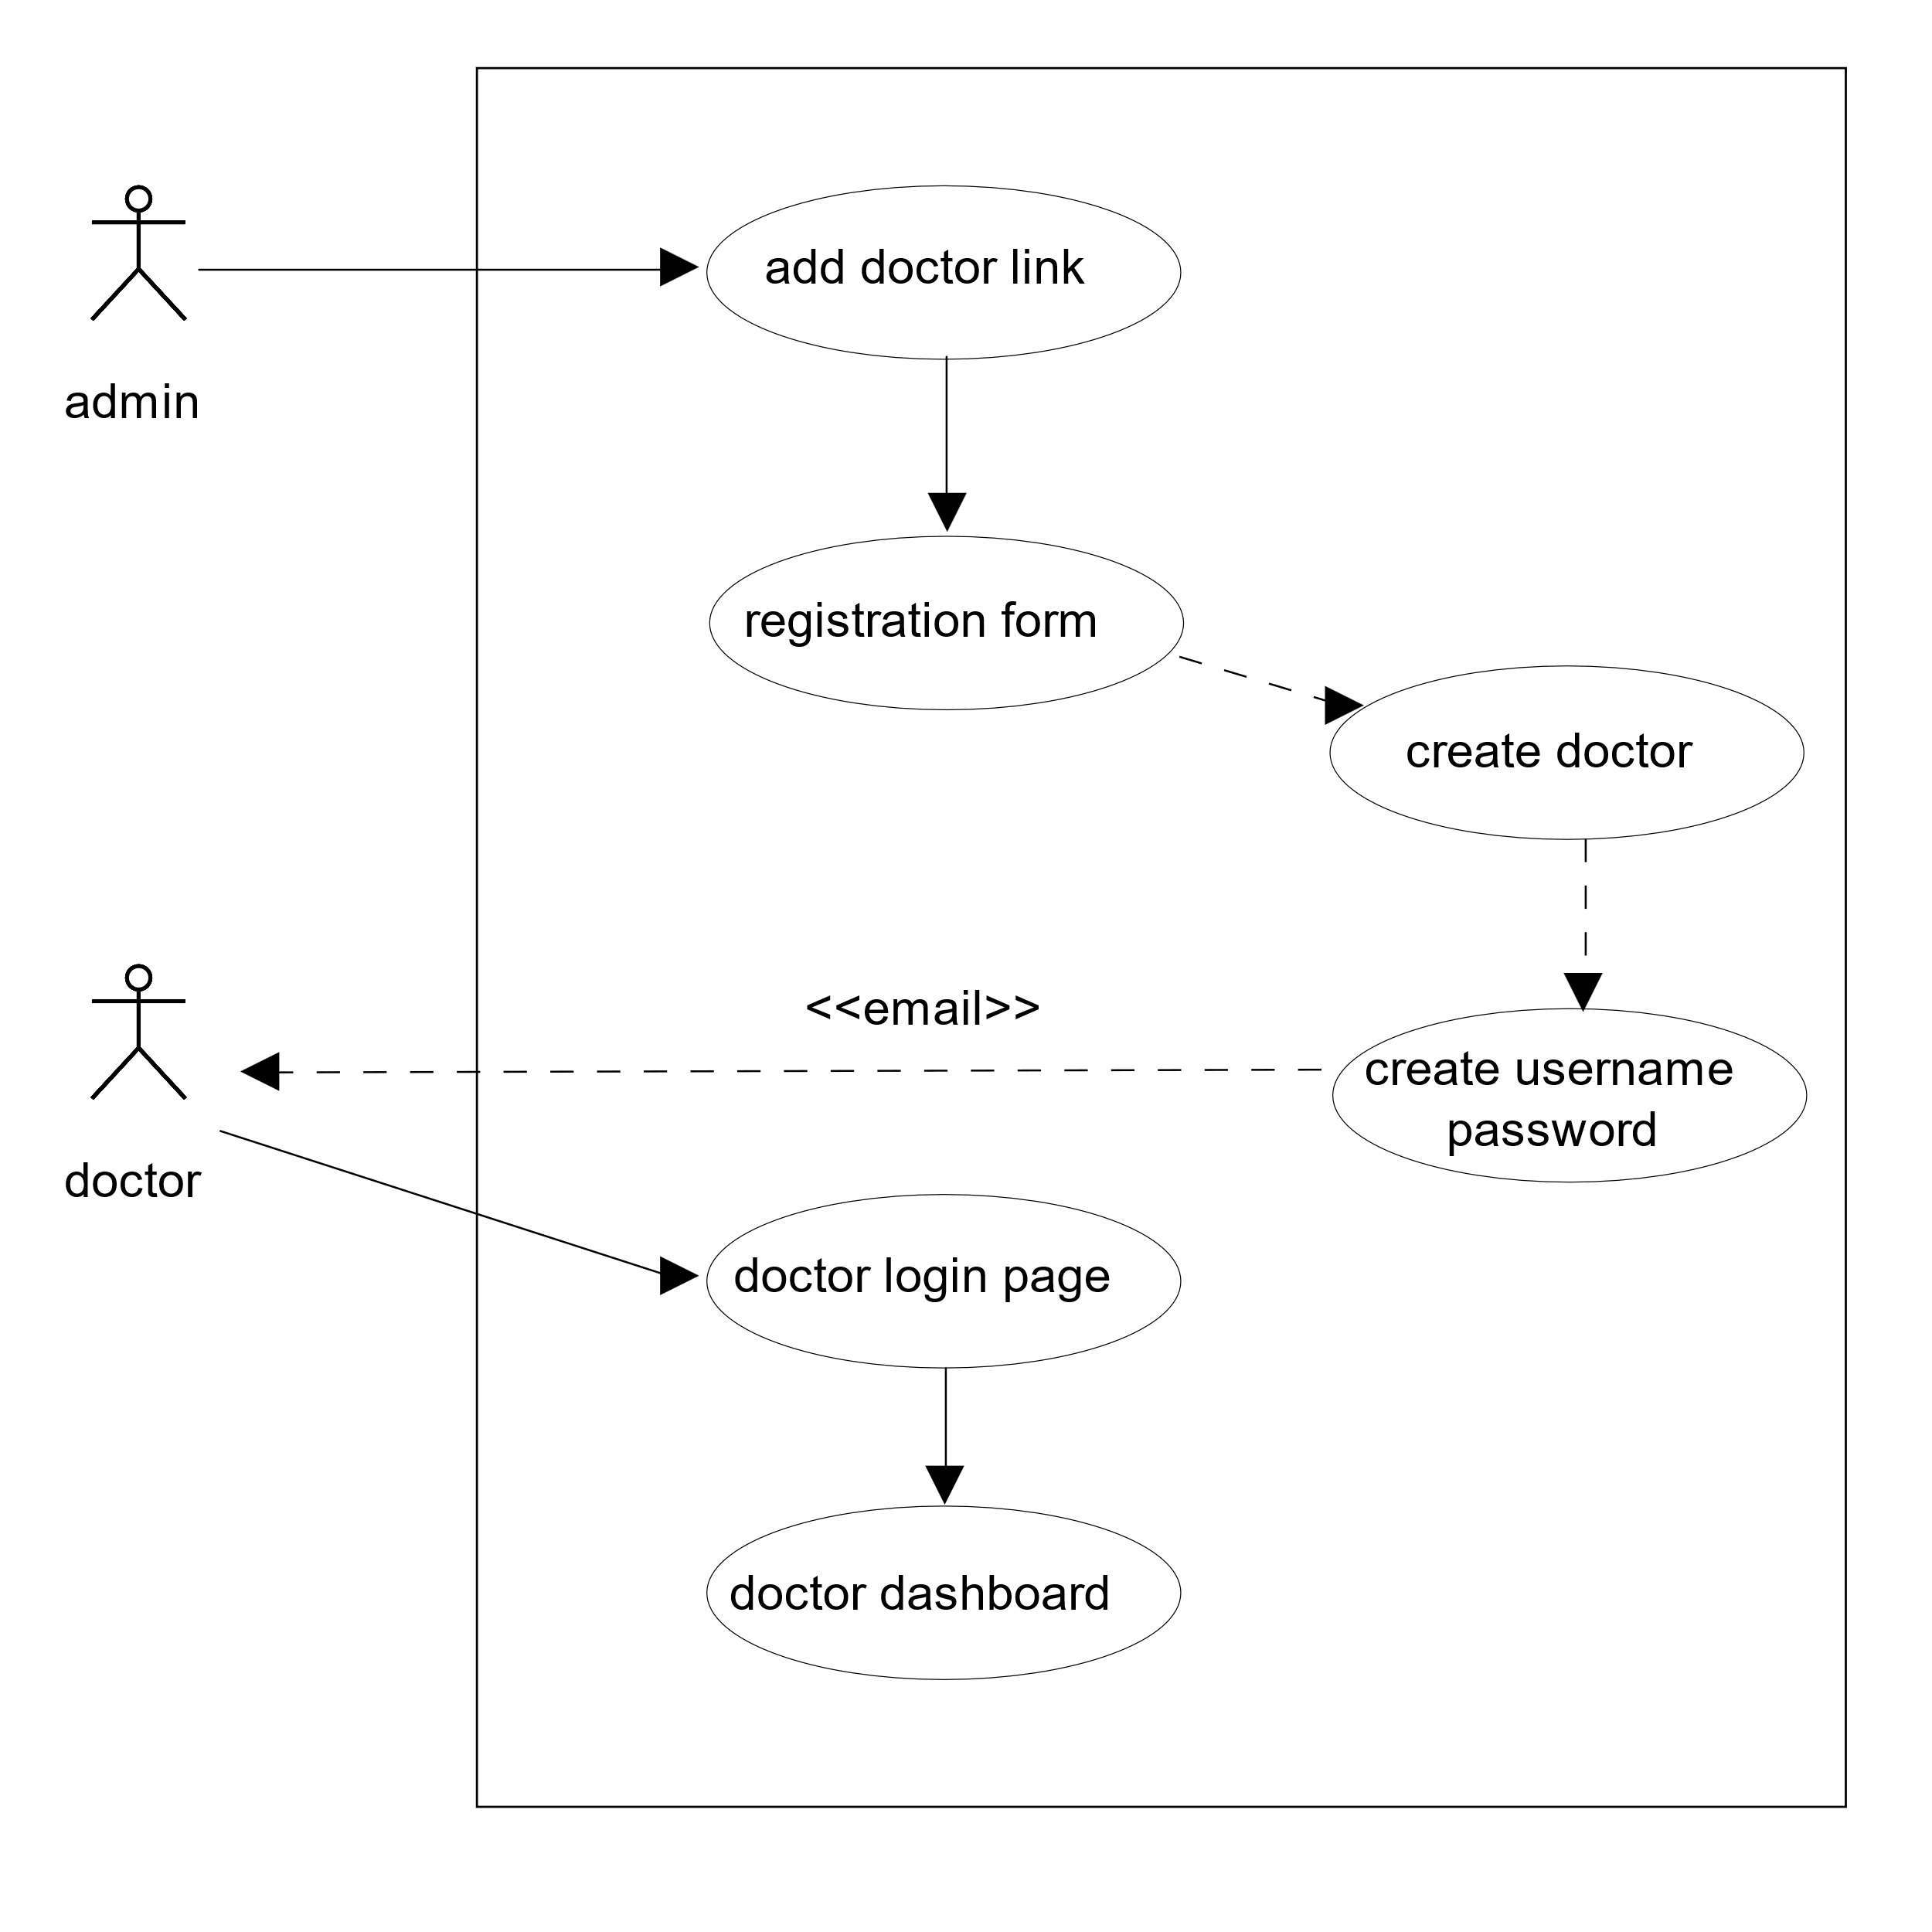
Admin – Add Doctor

Slide 8
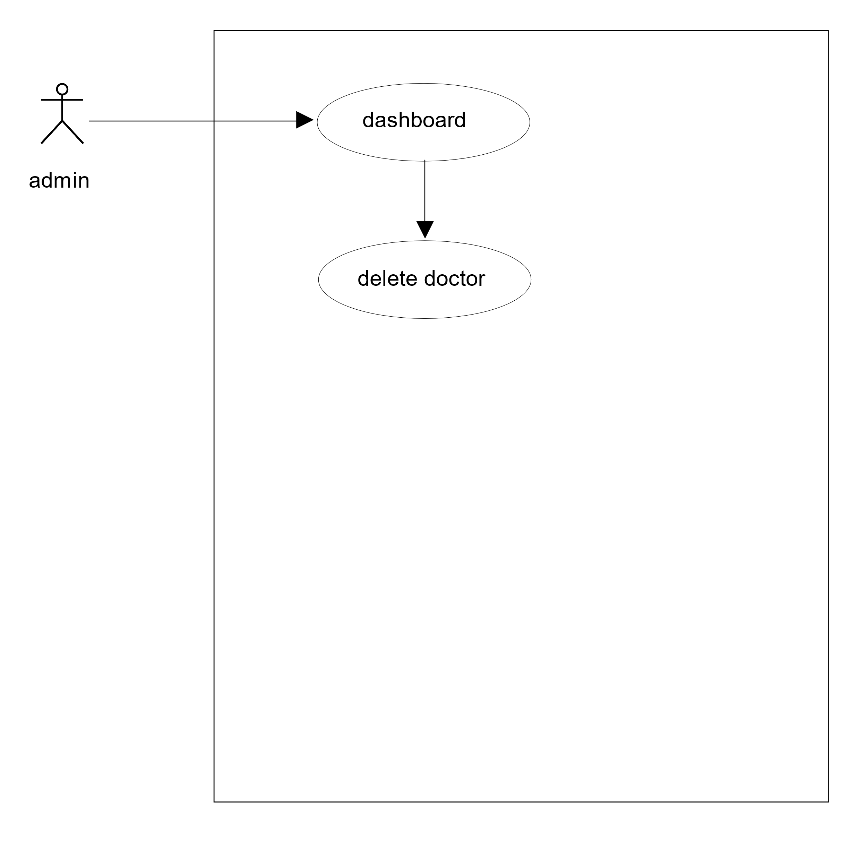
Admin – Delete Doctor

Slide 9
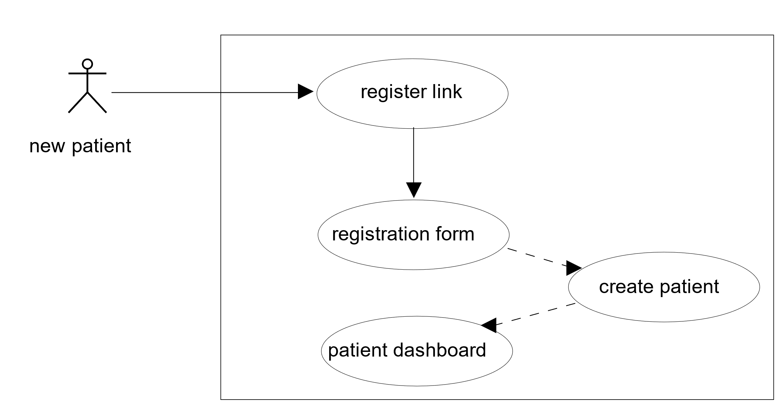
Patient - Register

Slide 10
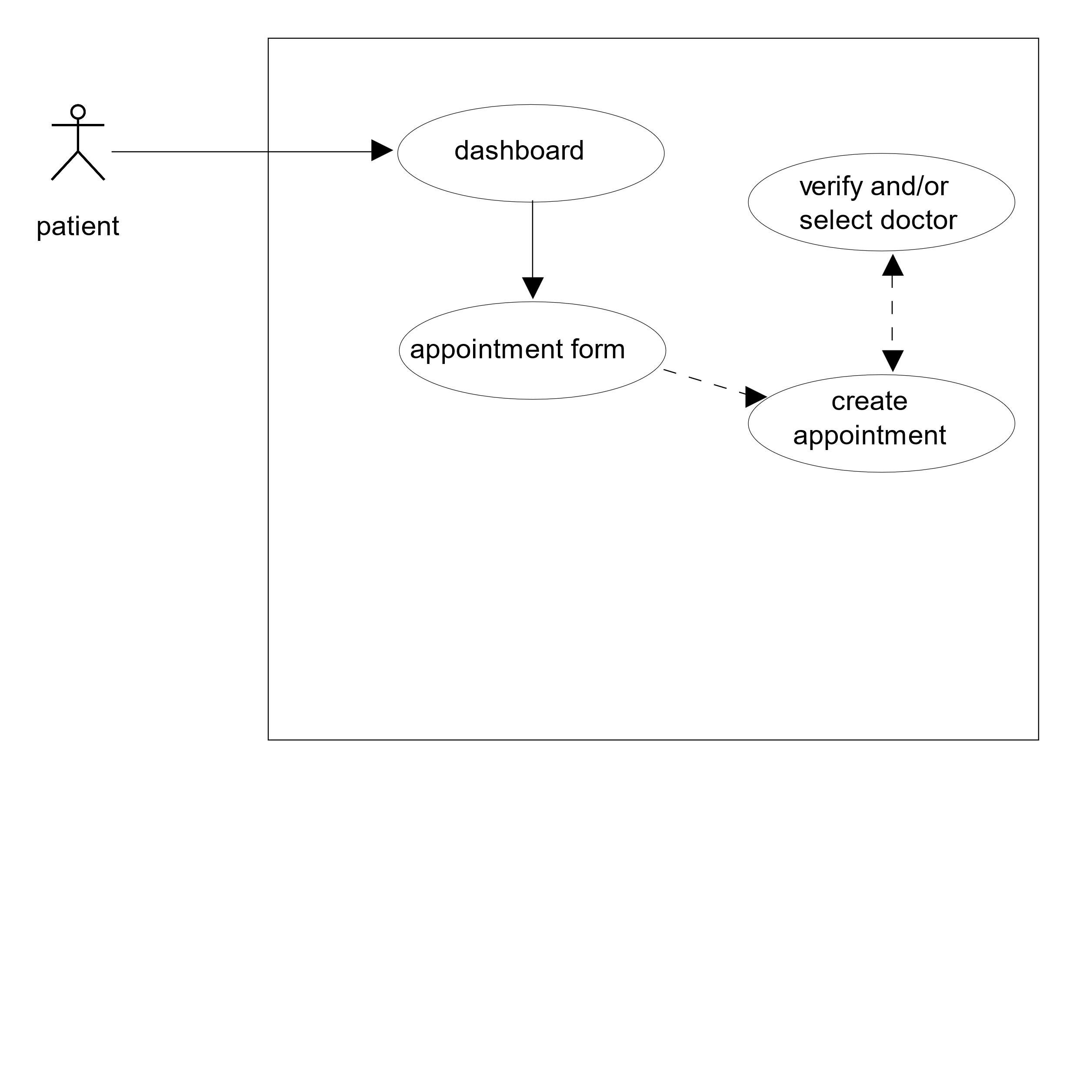
Patient – Create Appointment

Slide 11
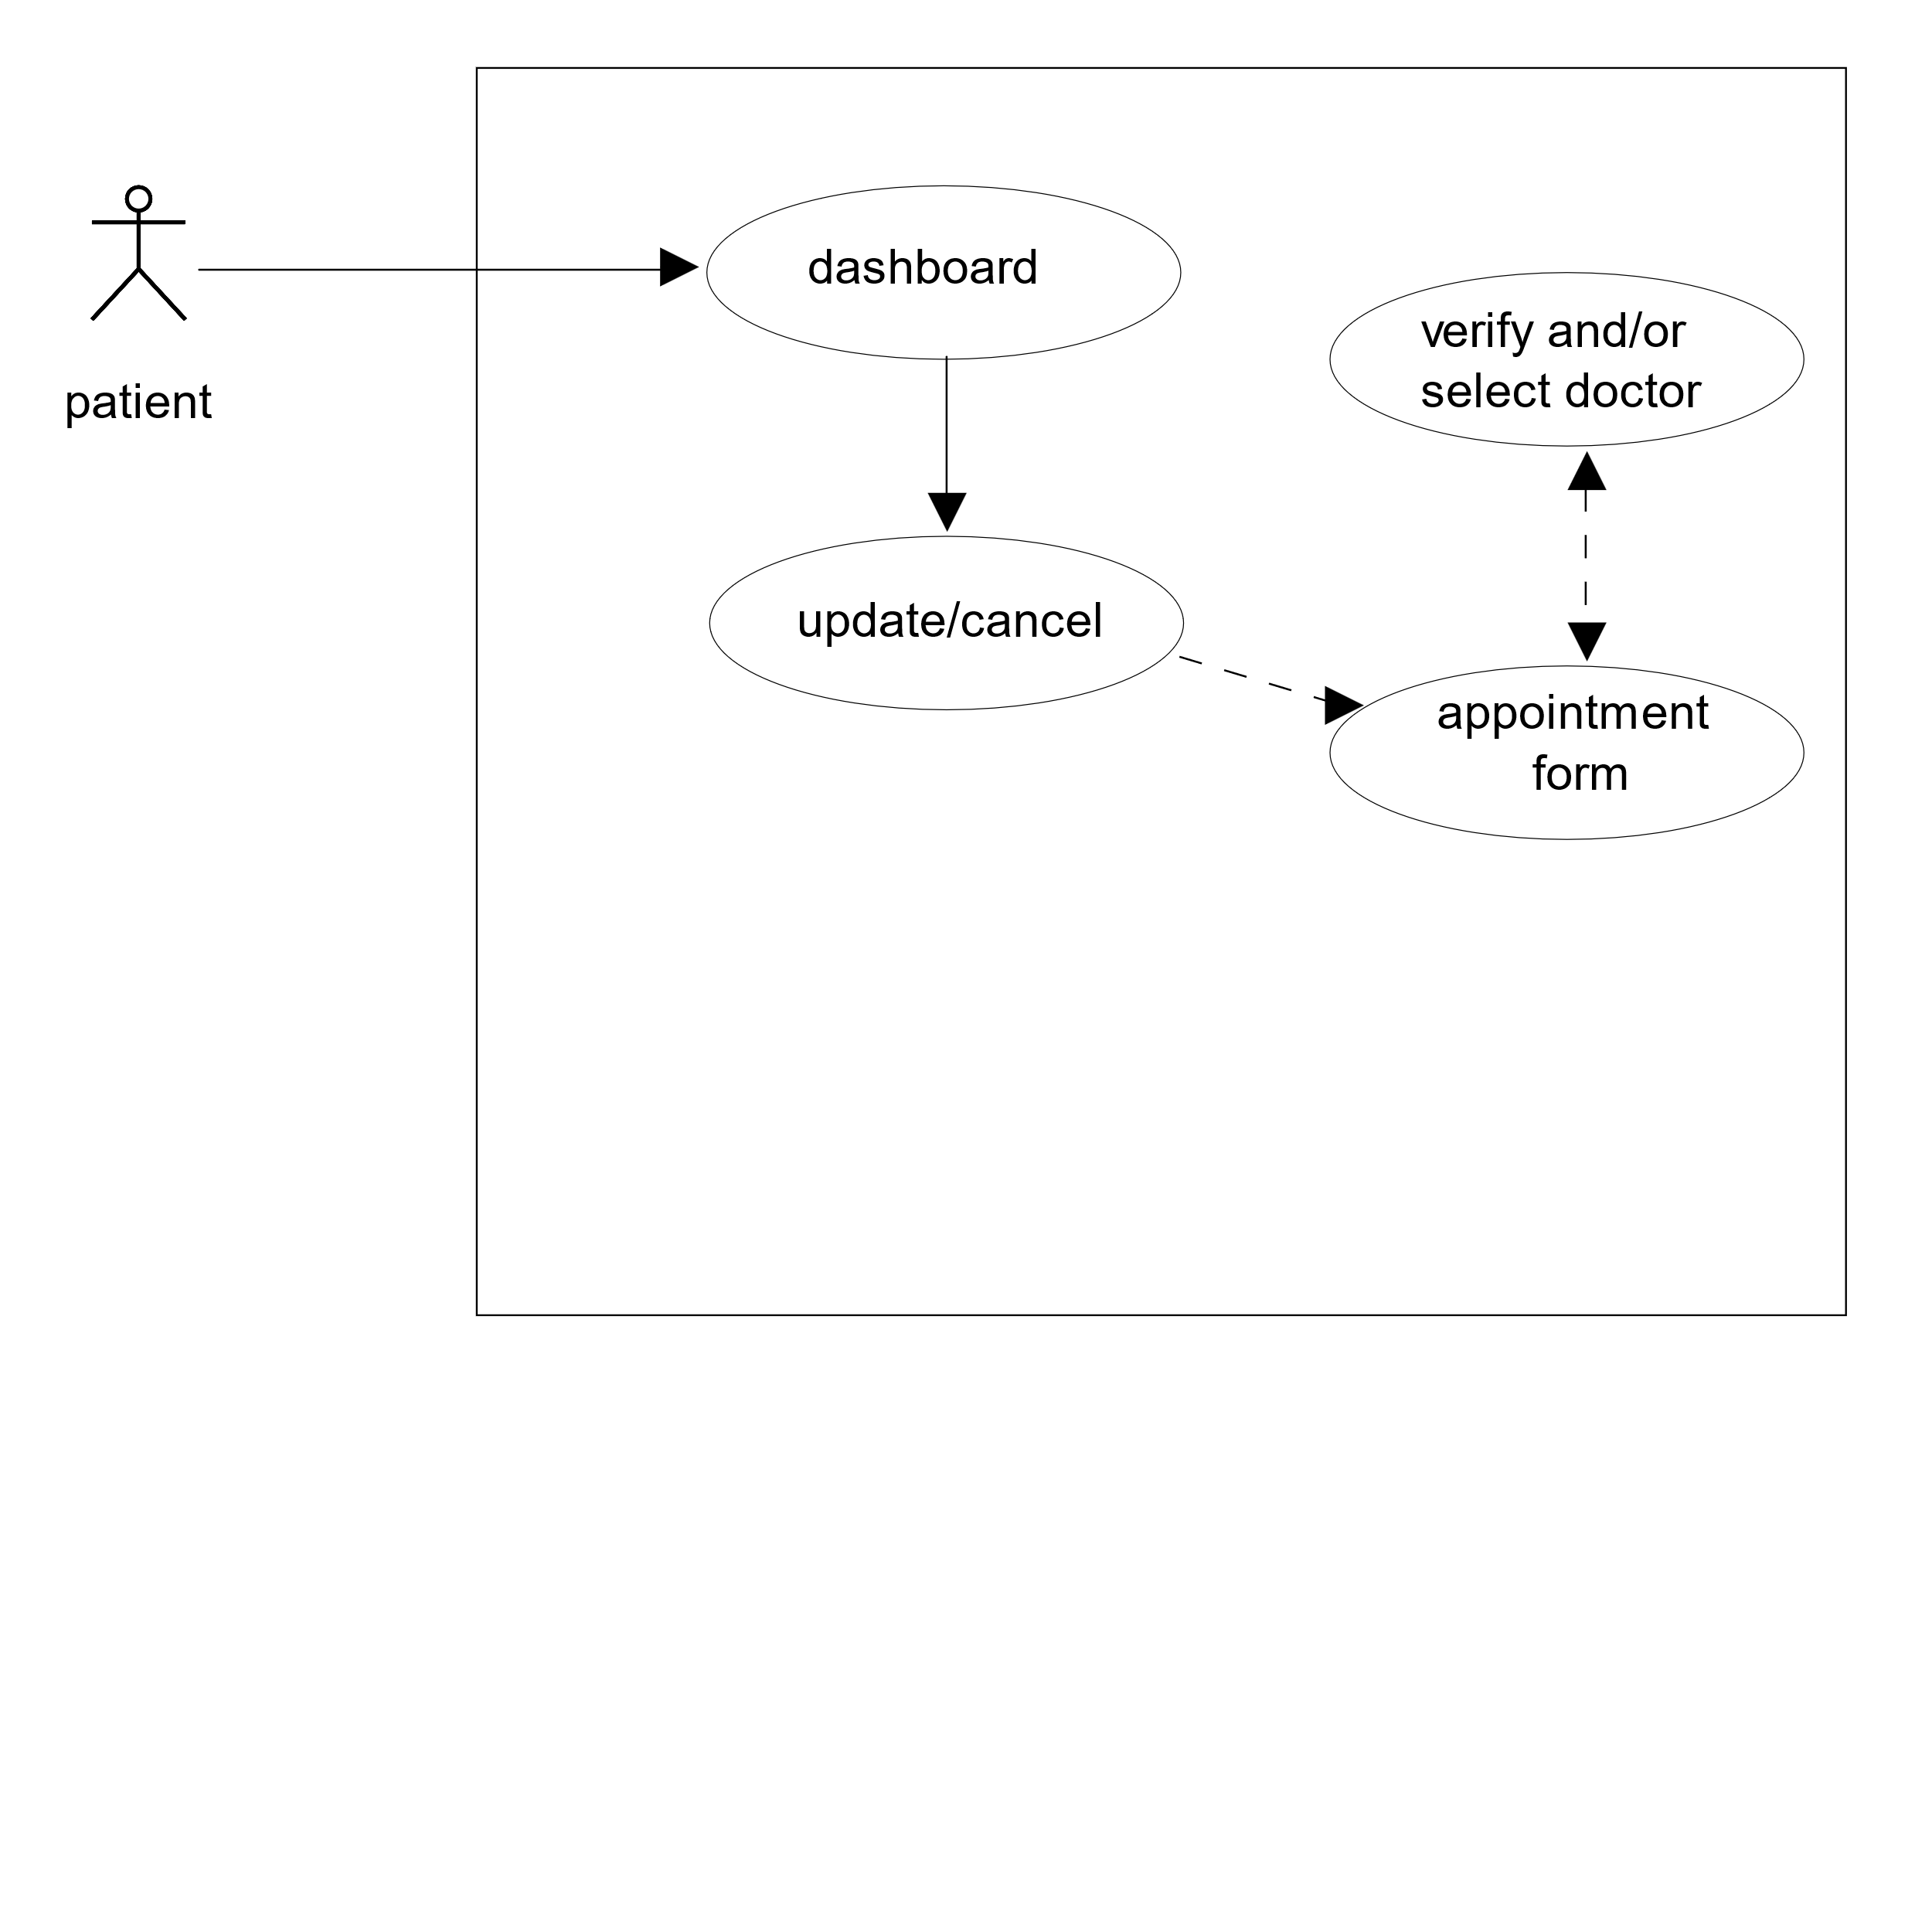
Patient – Update/Cancel Appointment

Slide 12
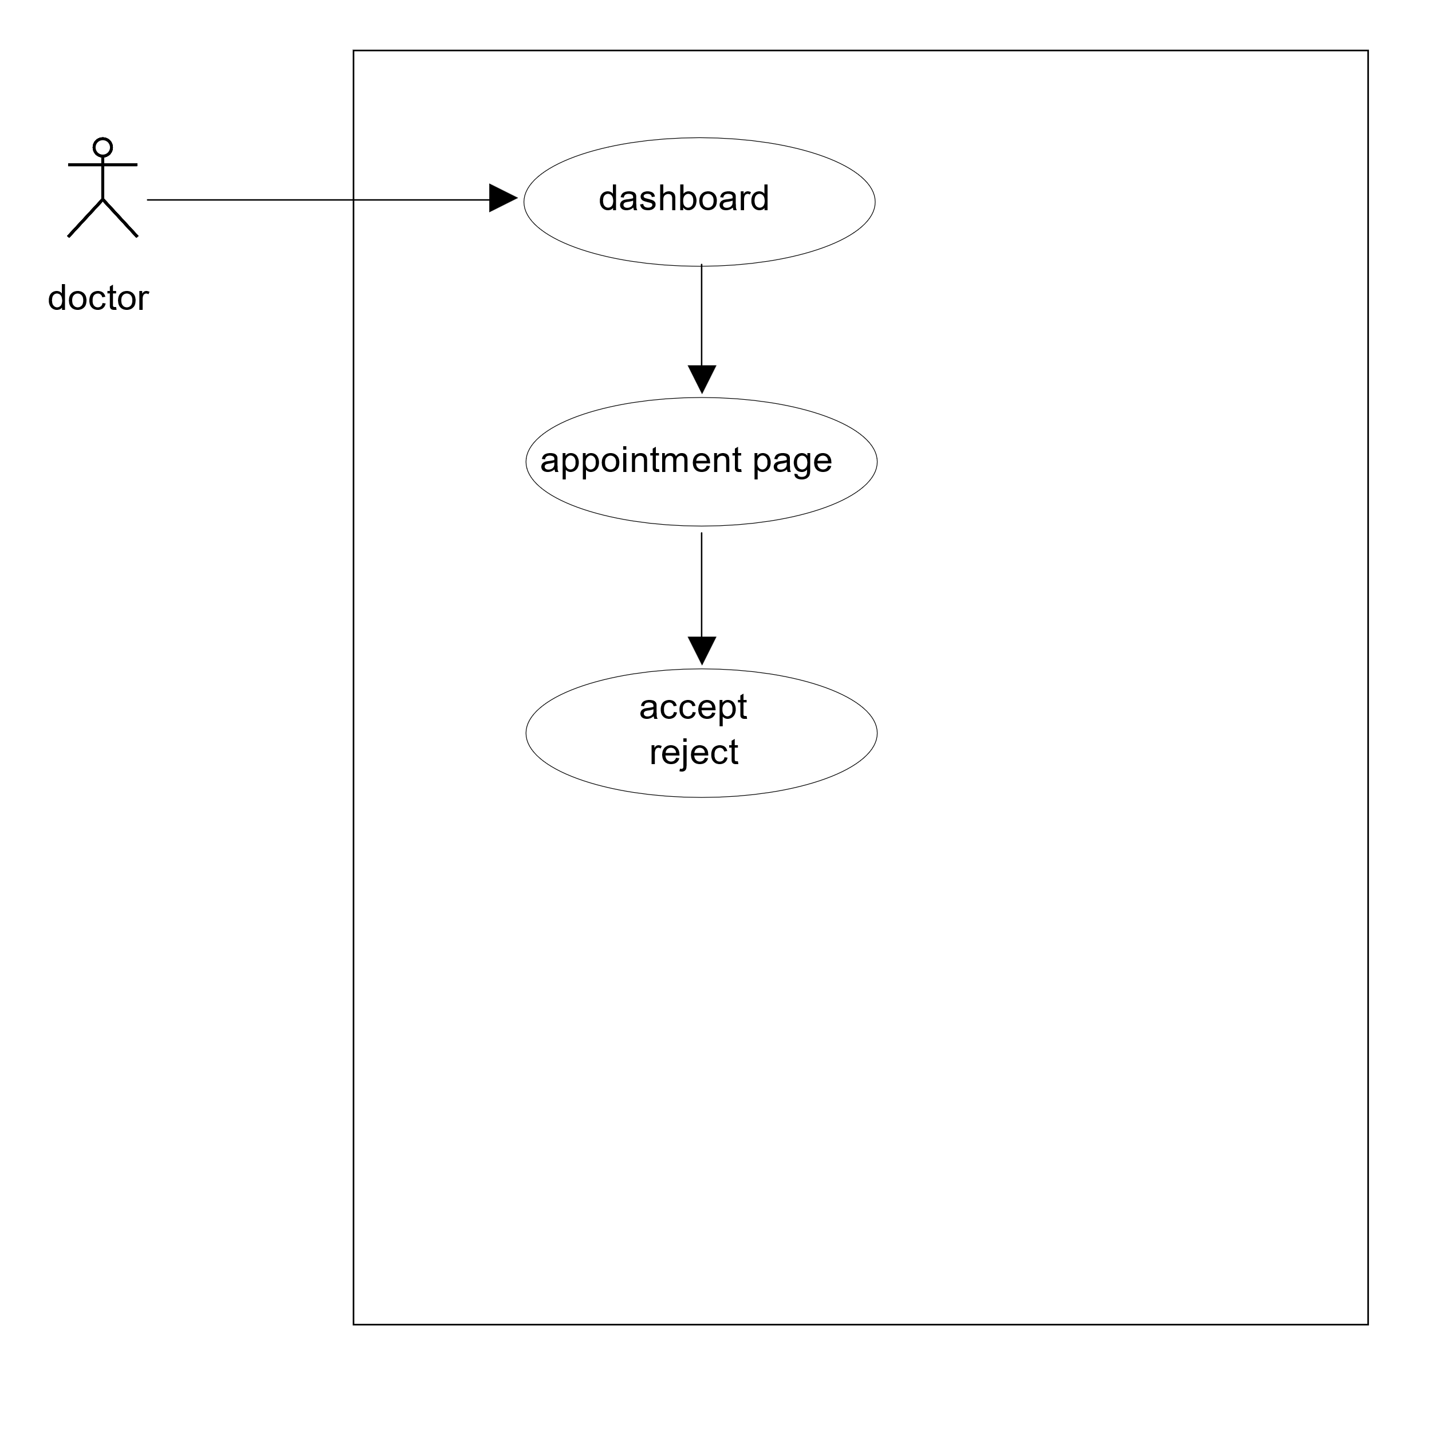
Doctor – Accept/Reject Appointment

Slide 13
Challenges
Finding portal logo and backdrop
Thymeleaf form+ dynamic behavior
Relationships between entities
Testing
Role based navigation

Slide 14
Future Considerations
Provide update doctor feature to Admin
More validation could be added
Notification email
Check doctor’s availability before appointment

Slide 15
Demo

Slide 16
Q n A ?

